Slide 1

FAKE NEWS DETECTION
B.VARSHA
E.RAMYASREE
G.NEHA G.VAMSHI KRISHNA
245321733138
245321733147
245321733149
245321733155
UNDER THE GUIDANCE OF:
DR.B.KRISHNA
ASSOCIATE PROFESSOR

Slide 2

INTRODUCTION
PROBLEM DEFINITION:
Fake News Detection: A Machine Learning Approach
The goal is to design and implement a system that can accurately detect and classify news articles as either "real" or "fake".
Need of the project:
Social media is a popular way to get news because it's cheap, easy to access, and information spreads quickly. However, these same advantages also make it easy for "fake news"—false and misleading information—to spread widely.
The "Fake News Detection" project aims to develop a system that uses advanced technology to identify and stop the spread of fake news, helping to ensure people get accurate information online.

Slide 3

OBJECTIVE OF THE PROJECT
The objective of this project is to develop and implement a robust system capable of accurately identifying and filtering out misinformation in digital content. Specific goals typically include:
Accuracy: Achieve high precision and recall in distinguishing between genuine and fake news articles to minimize false positives and negatives.
Scalability: Create a system that can handle large volumes of data from various sources, including text, images, and videos.
Real-time Detection: Enable timely identification and flagging of fake news to prevent its spread.
Feature Extraction: Develop effective methods for analyzing textual, visual, and metadata features to improve detection capabilities.
Adaptability: Ensure the model can adapt to evolving deceptive tactics and changing patterns in misinformation.

Slide 4

SOFTWARE REQUIREMENTS:
Operating System: Windows 10 or later
Programming Languages: Python (version 3.7 or later)
Development Environment: Jupyter Notebook or Google Colab
Libraries and Frameworks:
• Pandas
• NumPy
• Seaborn
• Matplotlib
• Scikit-learn (Sklearn)
• Regular Expression (re)
HARDWARE REQUIREMENTS:
Processor - i3 Processor (Min)
RAM - 4 GB (Min)
Disk Space - 4 GB free disk space(Min)

Slide 5

DATASET
We have two datasets:
"Fake.csv"
"True.csv"
"Fake.csv" contains fake news
"True.csv" contains true news.

Slide 6
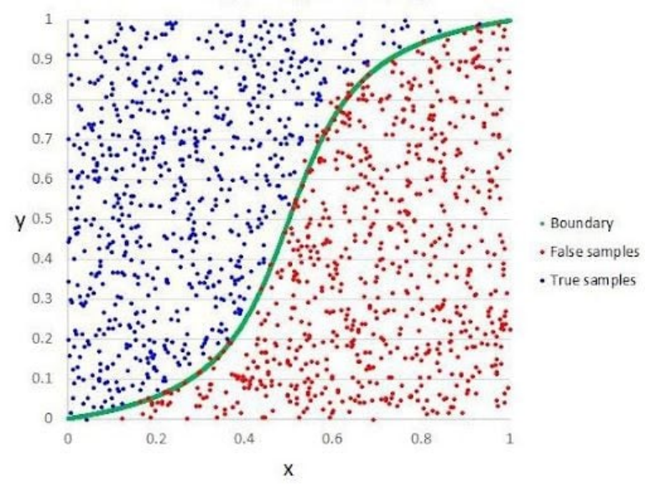
ALGORITHMS:
Logistic regression is a statistical and machine learning technique used for binary classification problems, where the goal is to predict one of two possible outcomes (e.g., yes/no, 0/1). It’s a type of regression model that estimates the probability that a given input belongs to a particular class.
(i) LOGISTIC REGRESSION:
Key Concepts:
1.Linear Model: Logistic regression starts with a linear equation combining the input features. This equation is similar to that used in linear regression.
2. Sigmoid Function: Unlike linear regression, logistic regression uses the sigmoid function to map the linear output to a probability value between 0 and 1. The sigmoid function is defined as:
σ(z)=1/1+e^-z
where z is the linear combination of input features.
3. Decision Boundary: The predicted probability is converted into a class label using a threshold, typically 0.5. If the probability is greater than 0.5, the input is classified into one class (e.g., 1); otherwise, it’s classified into the other (e.g., 0).
4.Training: The model is trained by minimizing the log-loss function (also known as binary cross-entropy), which measures the difference between the predicted probabilities and the actual class labels.

Slide 7
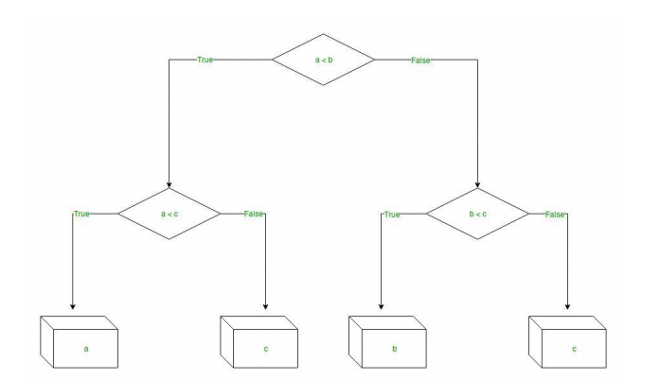
(ii) DECISION TREE:
A decision tree is a popular and interpretable machine learning algorithm used for both classification and regression tasks. It models decisions and their possible consequences as a tree-like structure, making it easy to understand and visualize.
Nodes: The tree consists of nodes, where each node represents a feature (or attribute) in the dataset. The root node is the first node, and it represents the most important feature according to a specific criterion.
Splitting: At each node, the dataset is split into subsets based on the value of a feature. The splitting criterion depends on the type of problem:
For classification, metrics like Gini impurity or information gain (based on entropy) are used to determine the best split.
For regression, the variance or mean squared error (MSE) is minimized to determine the splits.
Branches: Each branch represents a possible value of the feature and leads to either another decision node or a leaf node.
Leaf Nodes: Leaf nodes represent the outcome or the final decision. In classification tasks, they contain class labels; in regression, they contain continuous values.
Decision Path: To make a prediction, you follow the path from the root to a leaf, making decisions at each node based on the feature values of the input data.

Slide 8

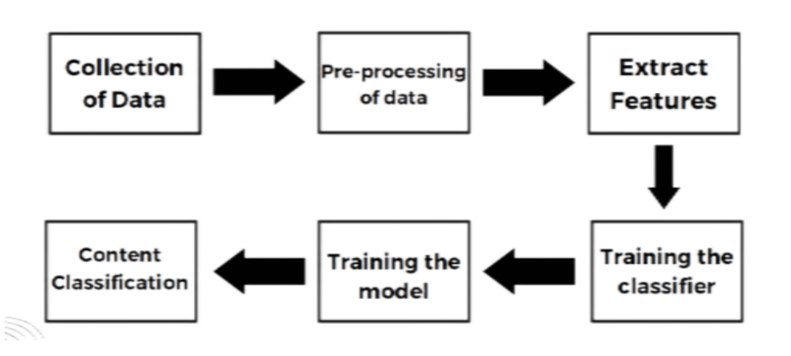
SYSTEM ARCHITECTURE

Slide 9
Implementation Steps
1
6
1.
Data Shuffling and Cleaning
Importing Libraries
Together, the project's vision and mission form the foundation
2
7
Importing Dataset
Splitting Data into Features and Labels
2.
3
Together, the project's vision and mission form the foundation
1.
8
Exploring and Modifying the Dataset
Text Vectorization
4
9
Preparing Data for Manual Testing
Modeling
3.
Together, the project's vision and mission form the foundation
5
10
Merging Datasets
Evaluation

Slide 10
1. Importing Libraries
import pandas as pd
import matplotlib.pyplot as plt
import numpy as np
import seaborn as sns
import string
import re
from google.colab import files
from sklearn.model_selection import train_test_split
from sklearn.metrics import accuracy_score
from sklearn.metrics import classification_report
2. Importing Dataset
uploaded = files.upload()
data_fake=pd.read_csv('Fake.csv')
data_true=pd.read_csv('True.csv')

Slide 11
3. Exploring and Modifying the Dataset
data_fake.head() and data_true.tail() are used to view the first few and last few rows of the datasets.
A new column class is added to label fake news as 0 and true news as 1.
The shape of the datasets is checked to understand the number of rows and columns.
data_fake.head()
data_true.tail()
data_fake["class"]=0
data_true["class"]=1
data_fake.shape, data_true.shape
4. Preparing Data for Manual Testing
You remove the last 10 rows from both data_fake and data_true datasets.
These removed rows are stored separately in data_fake_manual_testing and data_true_manual_testing.
data_fake_manual_testing = data_fake.tail(10)
for i in range(23480,23470,-1):
data_fake.drop([i],axis=0,inplace=True) data_true_manual_testing = data_true.tail(10)
for i in range(21416,21406,-1):
data_true.drop([i],axis=0,inplace=True) data_fake.shape,data_true.shape data_fake_manual_testing.loc[:,"class"]=0 data_true_manual_testing.loc[:,"class"]=1 data_fake_manual_testing.head(10) data_true_manual_testing.head(10)

Slide 12
5. Merging Datasets
Merging True and fake Dataframes
data_merge=pd.concat([data_fake,data_true],axis=0)
data_merge.head(10)
data_merge.columns
data=data_merge.drop(['title','subject','date'], axis = 1)
data.isnull().sum()
The data_fake and data_true DataFrames are merged into a single DataFrame data_merge.
Unnecessary columns like title, subject, and date are dropped since they are not required for the model.
6. Data Shuffling and Cleaning
data=data.sample(frac=1)
data.head()
data.reset_index(inplace = True)
data.drop(['index'],axis=1,inplace=True)
data.columns
data.head()
def wordopt(text):
text = text.lower()
text = re.sub('\[.*?\]','',text)
text = re.sub("\\W"," ",text)
text = re.sub('https?://\S+|www\.\S+','',text)
text = re.sub('<.*?>+',b'',text)
text=re.sub('[%s]'%re.escape(string.punctuation),'',text) text = re.sub('\w*\d\w*','',text)
return text
data['text'] = data['text'].apply(wordopt)
The dataset is shuffled randomly using data.sample(frac=1) to ensure that the model does not learn any specific order in the data.
The index column created after shuffling is dropped.
A function wordopt() is defined to clean the text data by:
Converting text to lowercase.
Removing unnecessary characters, punctuation, and digits.
The text column in the dataset is processed using this function.

Slide 13
7. Splitting Data into Features and Labels
x represents the feature set (text data).
y represents the target labels (class column).
The dataset is split into training and testing sets using train_test_split(), with 25% of the data reserved for testing.
x = data['text']
y = data['class']
x_train, x_test, y_train, y_test = train_test_split(x,y,test_size= 0.25)
8. Text Vectorization
The text data is converted into numerical vectors using TfidfVectorizer, which transforms text into a matrix of TF-IDF features.
xv_train and xv_test hold the transformed training and testing data.
from sklearn.feature_extraction.text import TfidfVectorizer vectorization=TfidfVectorizer()
xv_train=vectorization.fit_transform(x_train)
v_test = vectorization.transform(x_test)

Slide 14
9. Modeling and Evaluation
Logistic Regression:
The logistic regression model (LogisticRegression) is trained on the training data (xv_train, y_train).
Predictions are made on the test data (xv_test), and the accuracy and classification report are generated.
Decision Tree Classifier:
The decision tree classifier (DecisionTreeClassifier) is similarly trained and evaluated.
#Decision Tree Classifier
from sklearn.tree import DecisionTreeClassifier
DT = DecisionTreeClassifier()
DT.fit(xv_train, y_train)
pred_dt = DT.predict(xv_test)
DT.score(xv_test, y_test)
print (classification_report(y_test, pred_lr))
#Logistic Regression
from sklearn.linear_model import LogisticRegression
LR = LogisticRegression()
LR.fit(xv_train, y_train)
pred_lr = LR.predict(xv_test)
LR.score(xv_test, y_test)
print (classification_report(y_test, pred_lr))

Slide 15
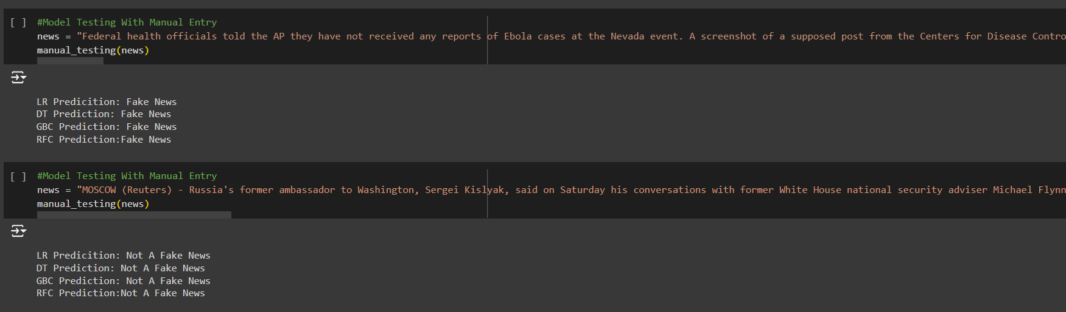
TESTING

Slide 16

THANK YOU

